Slide 1


Slide 2
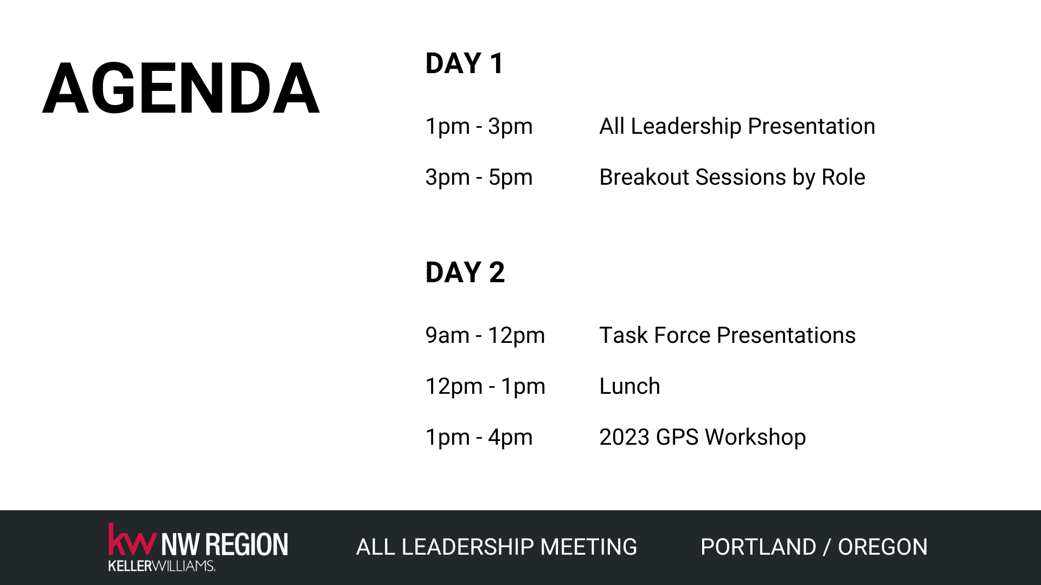

Slide 3
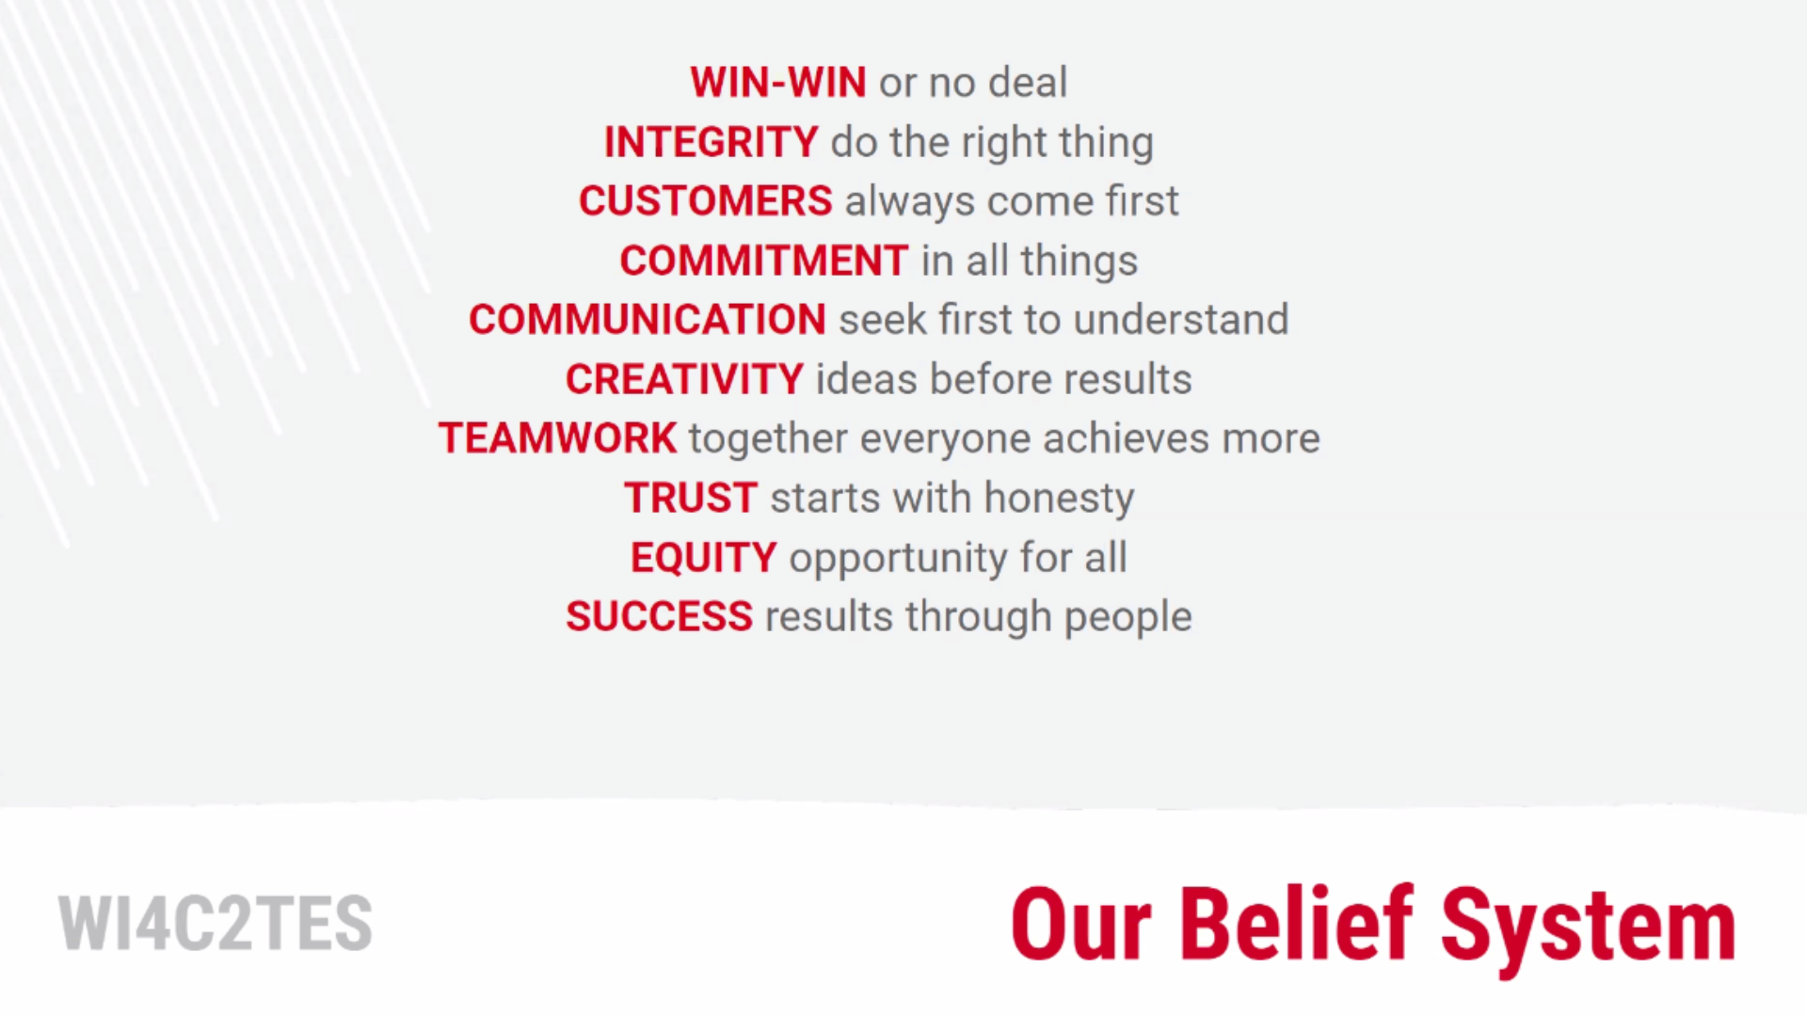

Slide 4
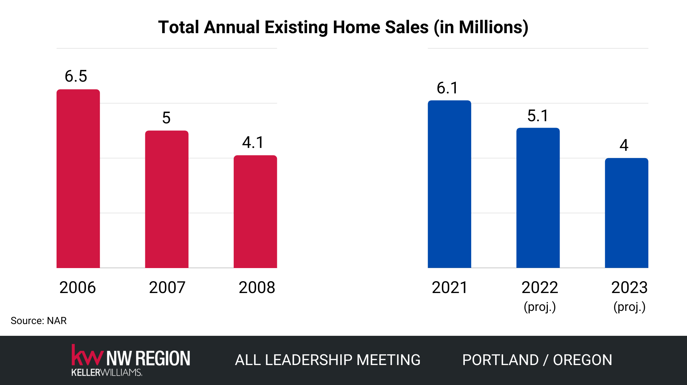

Slide 5

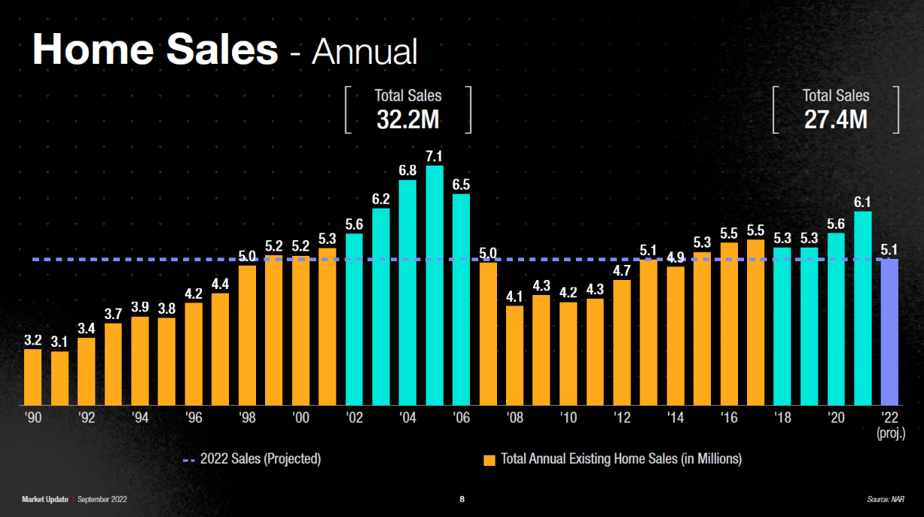

Slide 6
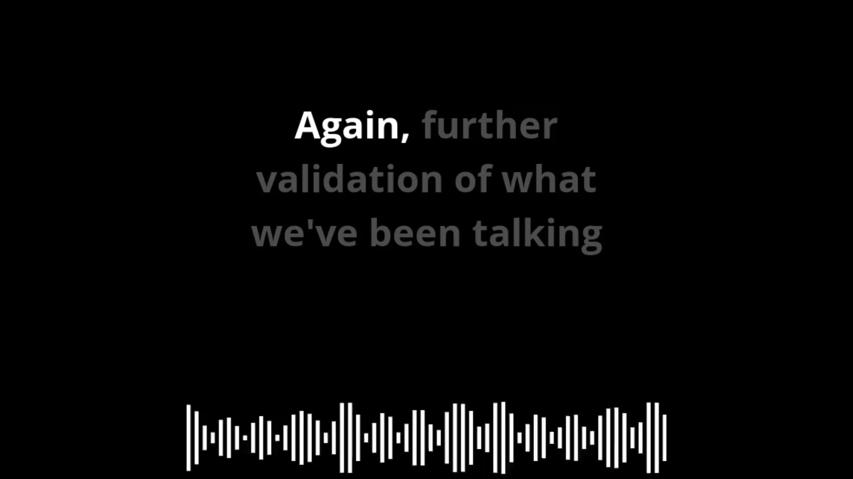

Slide 7
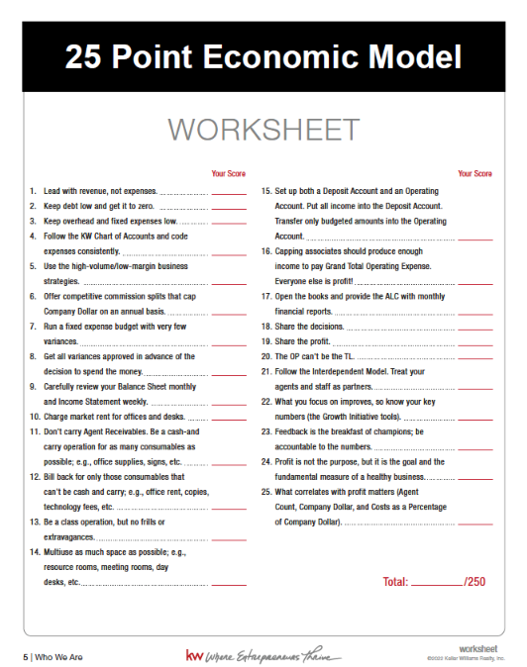

Slide 8
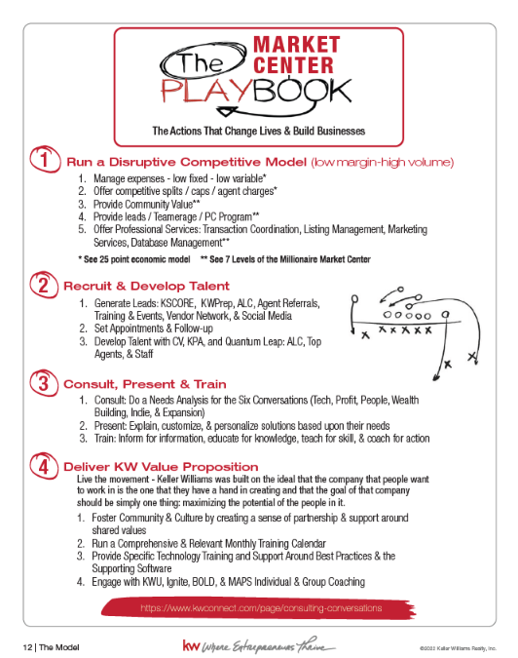

Slide 9


Slide 10
The Seven Levels
of the
Millionaire Market Center

Slide 11
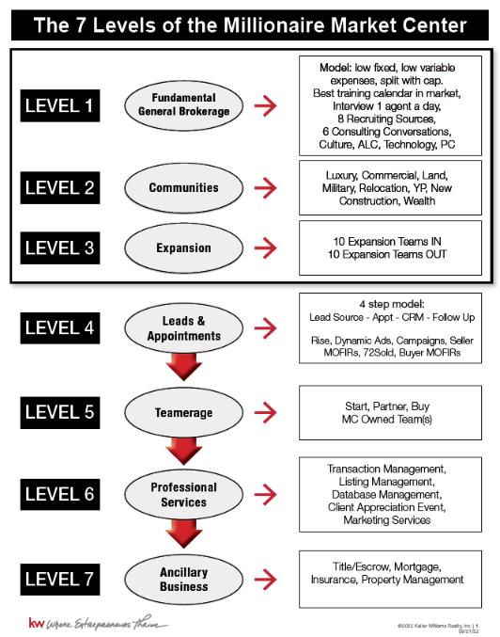

Slide 12
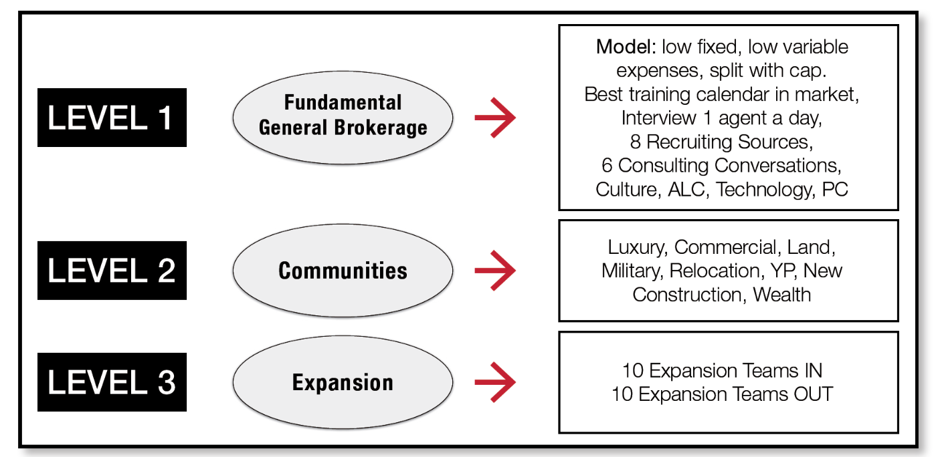

Slide 13
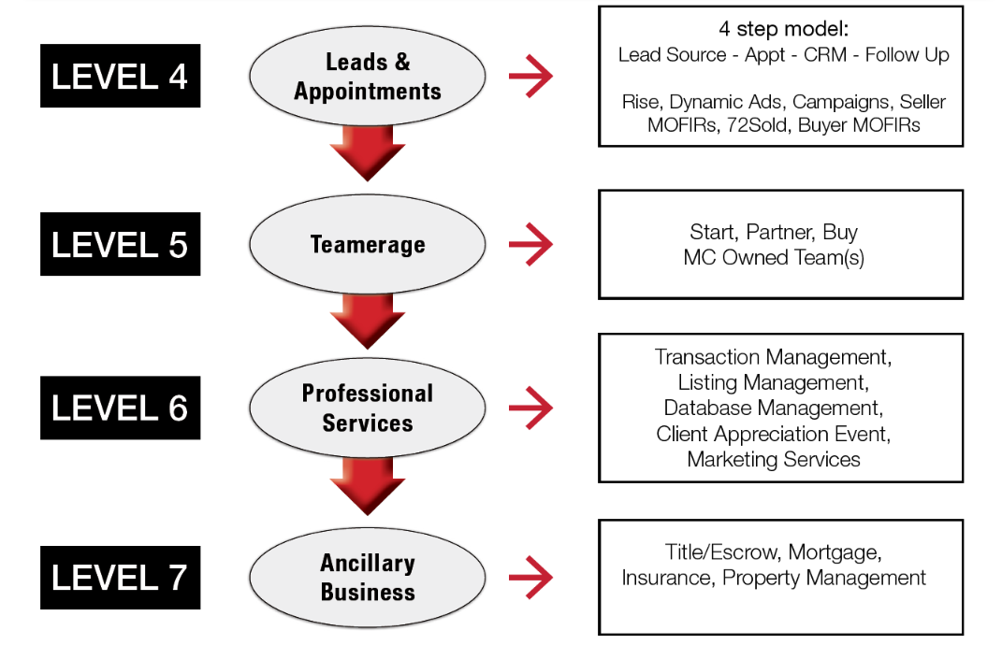

Slide 14
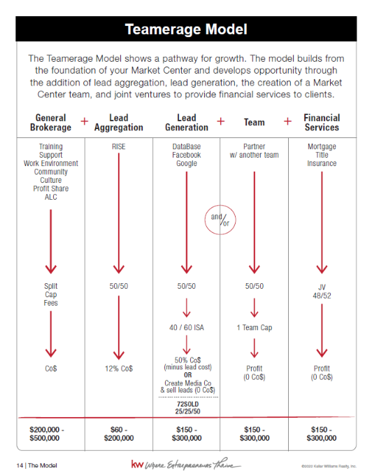

Slide 15
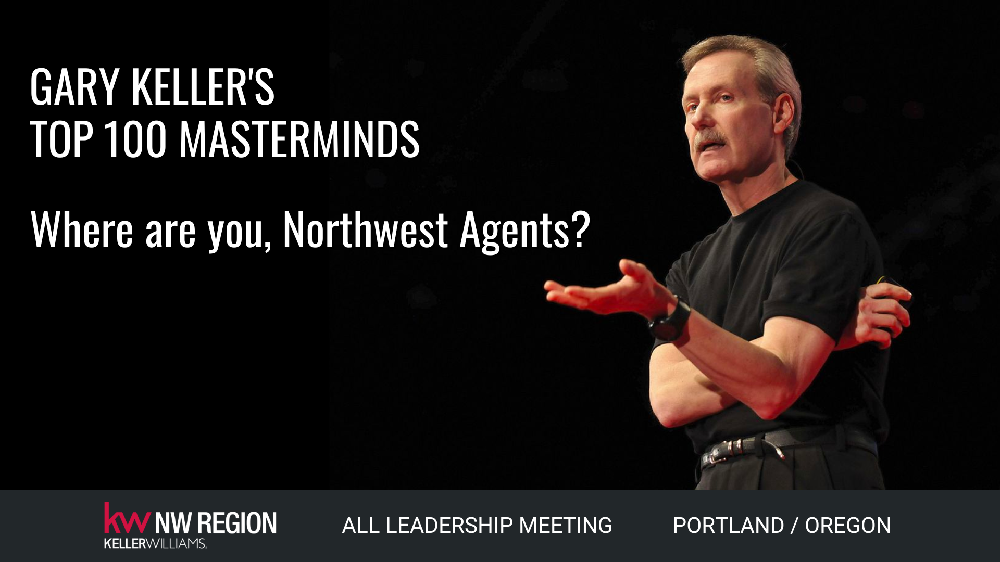

Slide 16
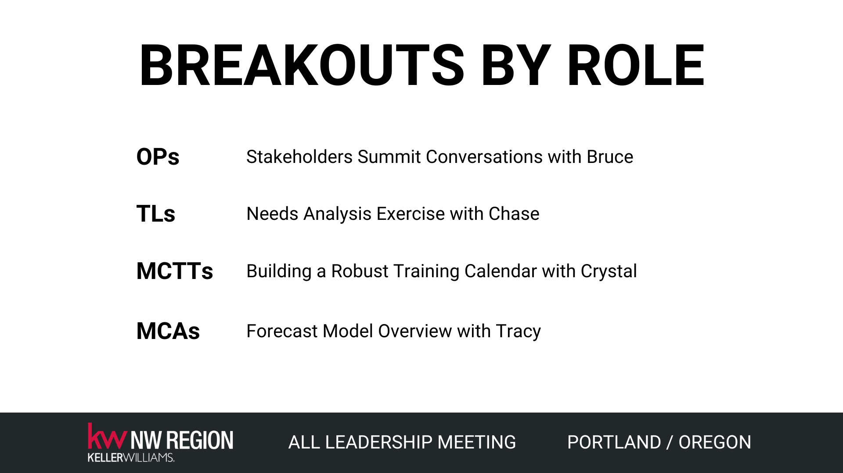

Slide 17


Slide 18
Onboarding that works
KWNW Regional Task force

Slide 19
What is onboarding?
Onboarding is not just licensing and misc forms. A good onboarding system creates an experience where existing company affinity is deepened and strengthened. A good onboarding system can take several years to complete.

Slide 20
Step One:
We listed everything we could possibly think of related to real estate onboarding for an agent regardless of industry tenure.
We started by grouping them into three main categories:
Our Market Center
KWRI
Industry/NAR
This took us several hours and it filled a 4’x 8’ whiteboard.

Slide 21
Step two:
We then took these lists and refined them by identifying when a broker would need to know each item- 30-days 60-days, 90-days or beyond.
Step three:
Once we had our lists, we left them alone for awhile, revisiting them each week to add or refine them further. This process took a month or two.

Slide 22
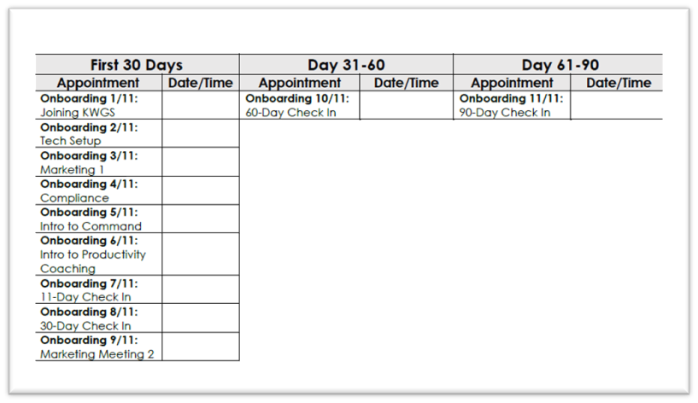
Step four:
we drafted our first 30, 60, 90-day checklists for our onboarding program.

Slide 23
Step five:
We compiled all the supplemental information necessary to support each checklist item, grouping them into “Chapters” (See the table of contents)
Step six:
We then drafted the Standard Operating Procedure (SOP) of managing the onboarding program, working to identify weaknesses or oversights in the system.

Slide 24
Step seven:
We launched the onboarding system and quickly realized we missed A LOT!!
We set quarterly reviews on the calendar to revisit the system and process. This time allowed us to determine if an issue was systemic or a “one off.”
Eventually reviews were set at six-month intervals and then one year.

Slide 25
What we’re adding this year:
Things we’ve added our system that are not included in the example:
• Agent Safety
• DEI initiatives
• Commercial transaction information

Slide 26
Career Opportunities- KSCORE & KWPREP
Task Force

Slide 27
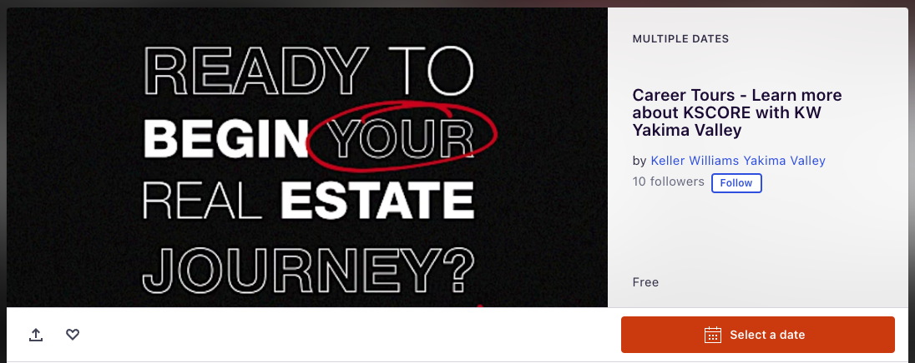
Before your Career Tour - Have an Eventbrite made to capture their information

Slide 28

During your Career Tour: Have a powerpoint available with information

Slide 29
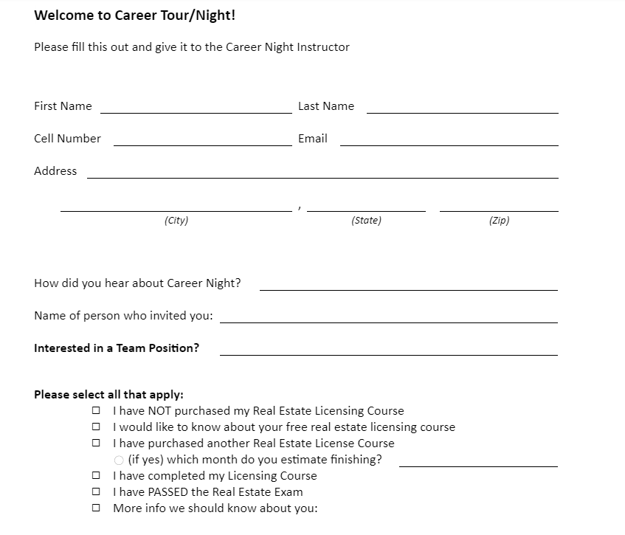
Don’t forget to have them sign in and put where they are at in the process of licensing and who referred them.

Slide 30
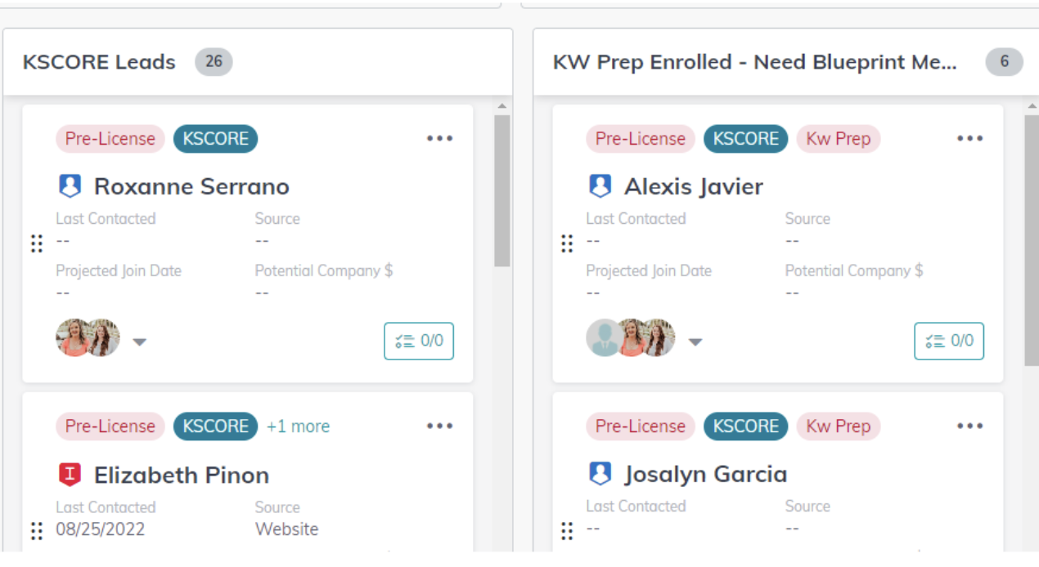
Here is an example of what it would look like in Command

Slide 31
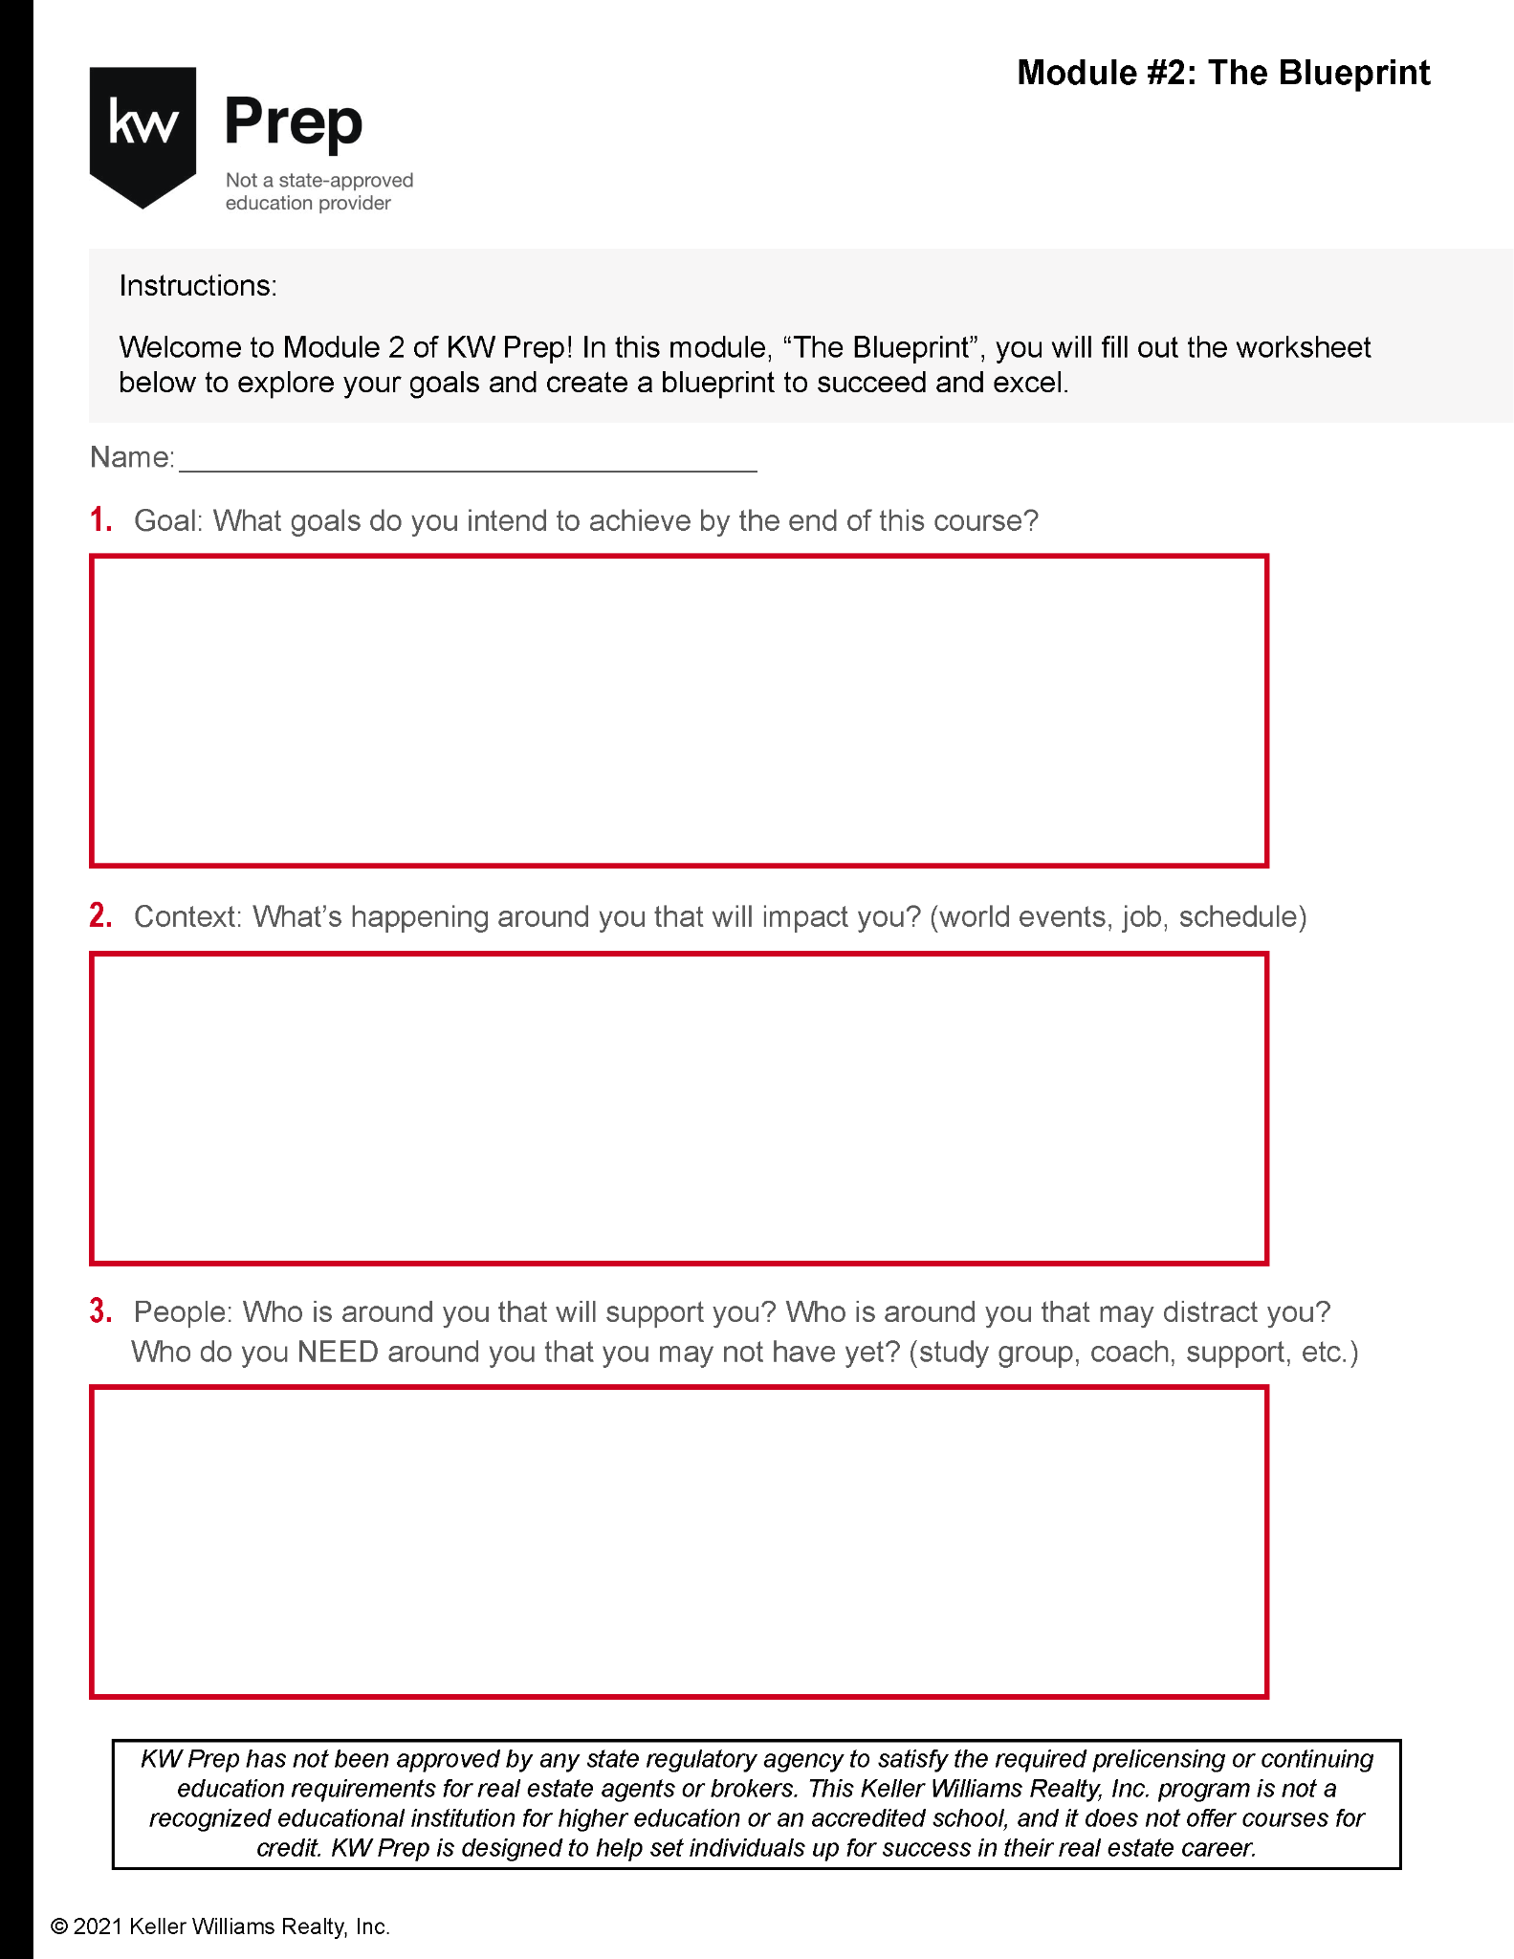

Slide 32
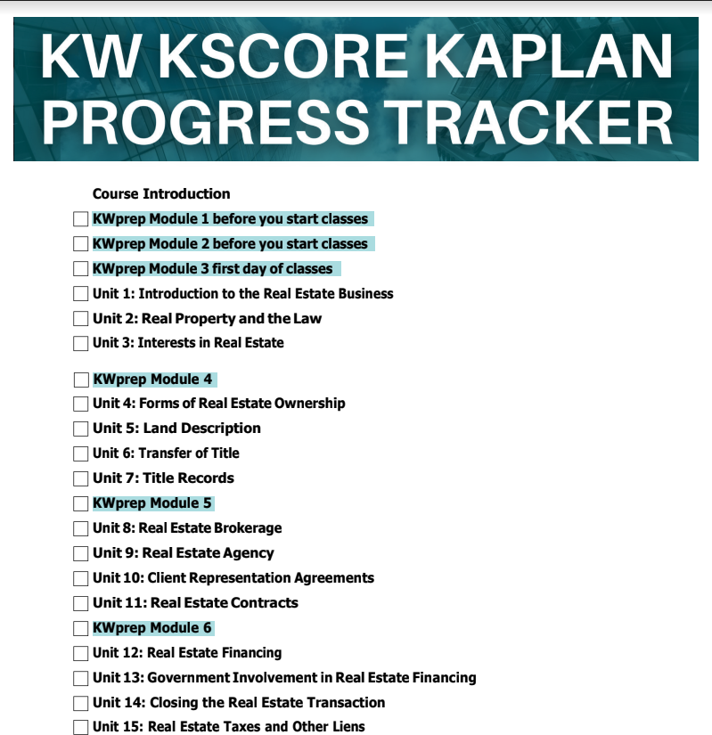

Slide 33
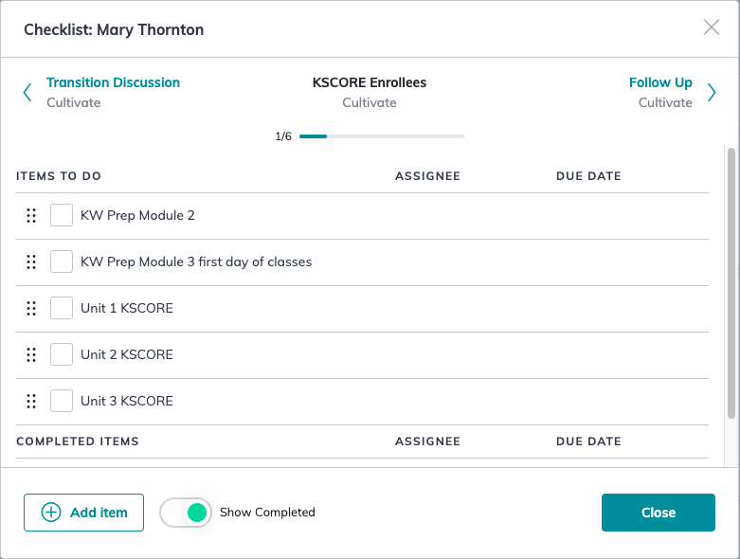
Here is what it would look like in Command

Slide 34
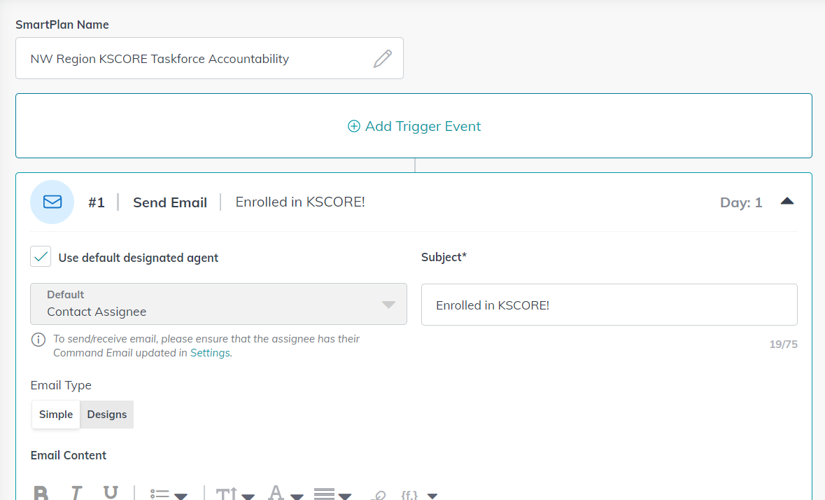

Slide 35
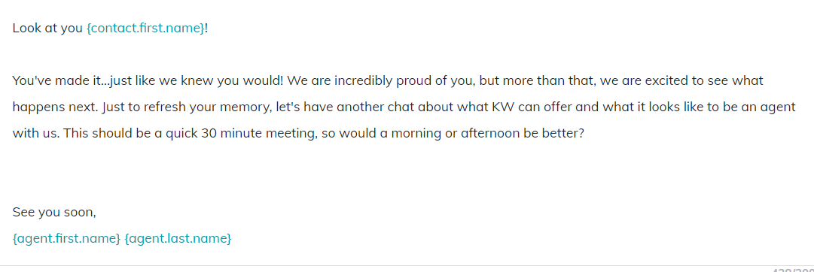
This is when you get to go for the close!

Slide 36


Slide 37


Slide 38


Slide 39
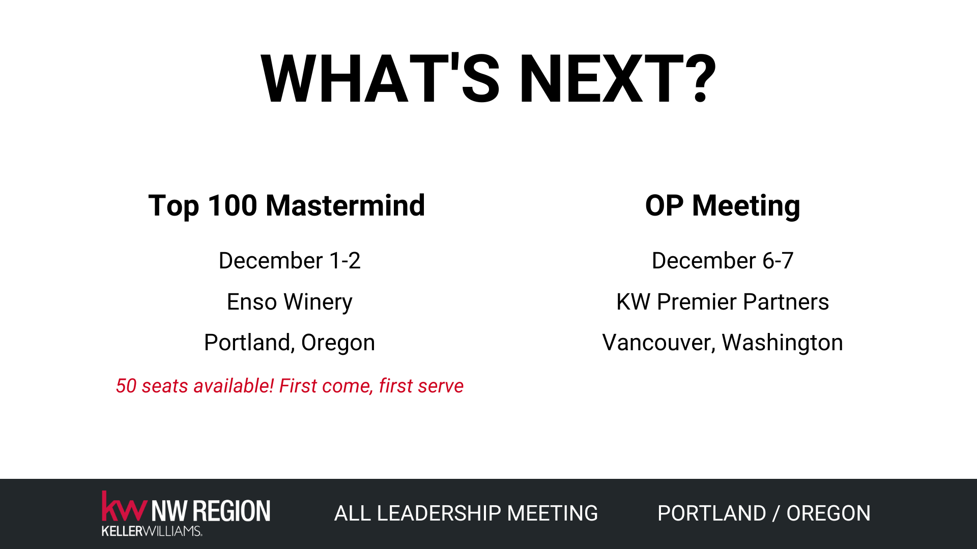

Slide 40
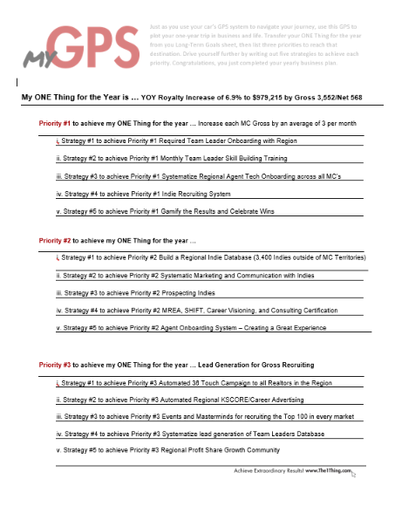

Slide 41
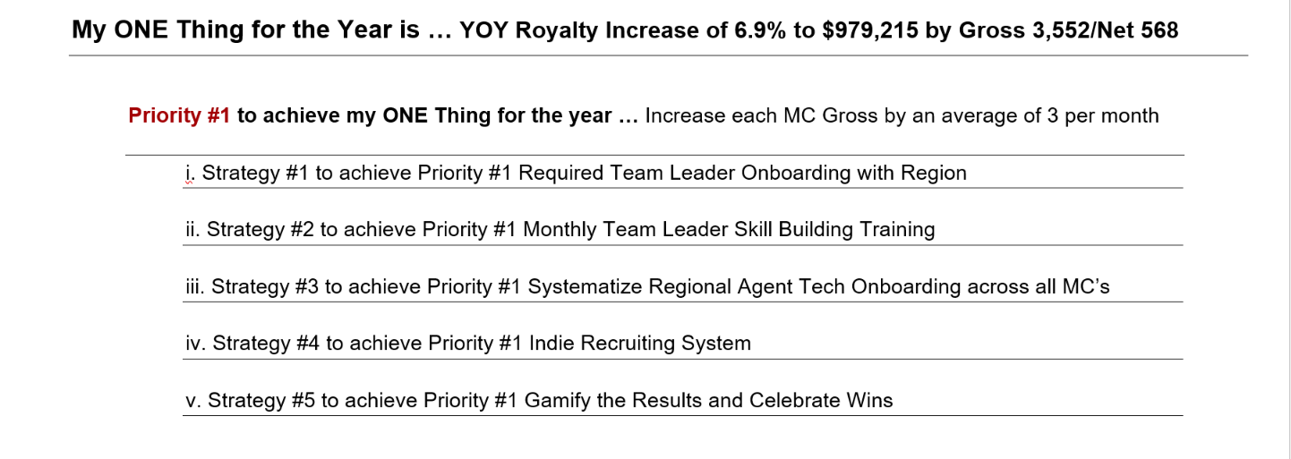

Slide 42
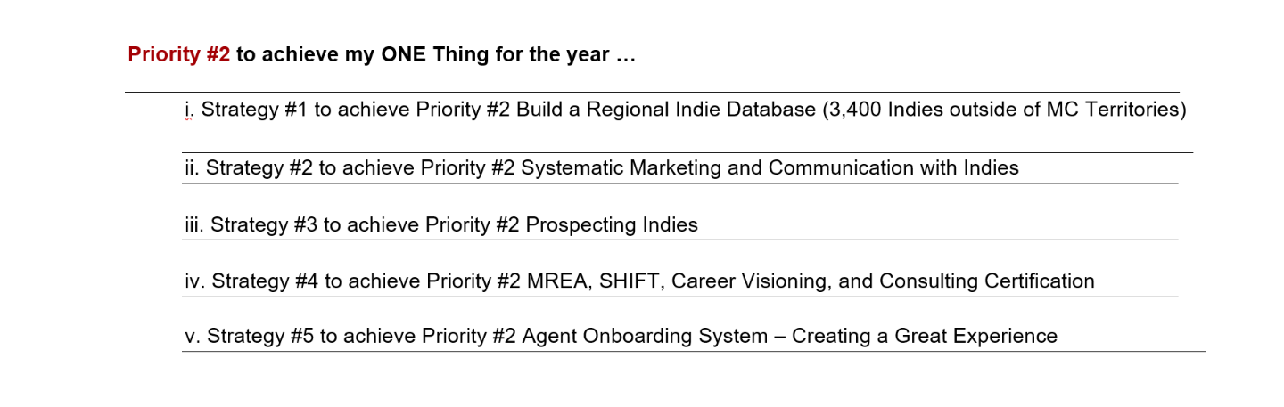

Slide 43
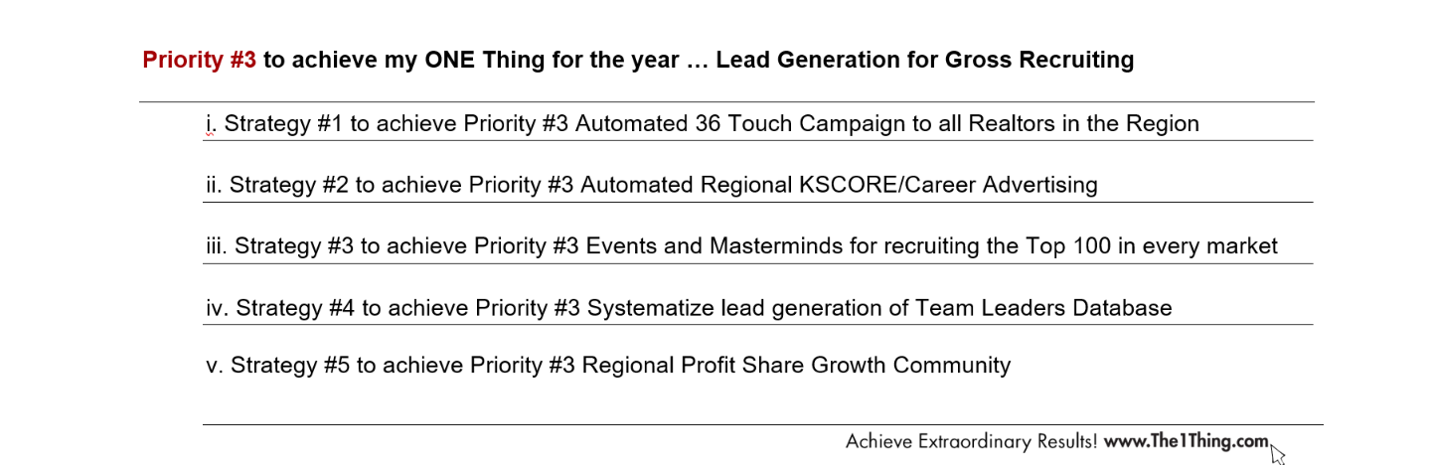

Slide 44
